Slide 2
„FOTO“

Slide 3
What are we doing?

Slide 4
Advertisement!

Slide 5
What are we diferent of orther companies?

Slide 6
We are cheap!

Slide 7
We are cheap!
We are young and creative!

Slide 8
We are cheap!
We are young and creative!
We are not scarry about controversion!

Slide 9
Things we have done yet

Slide 11
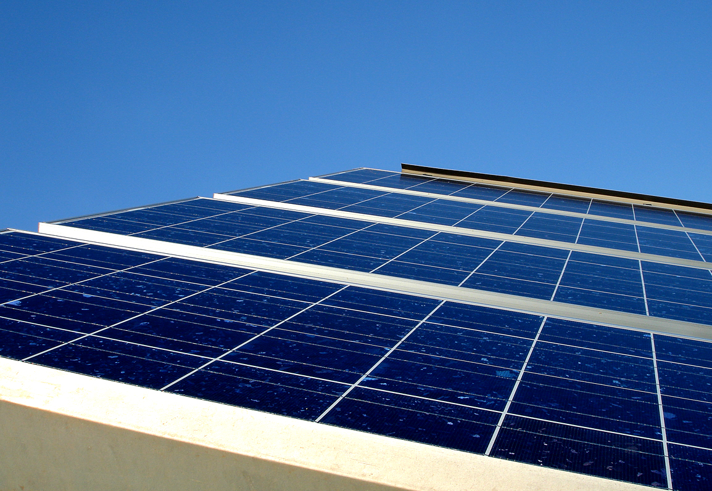

Slide 13
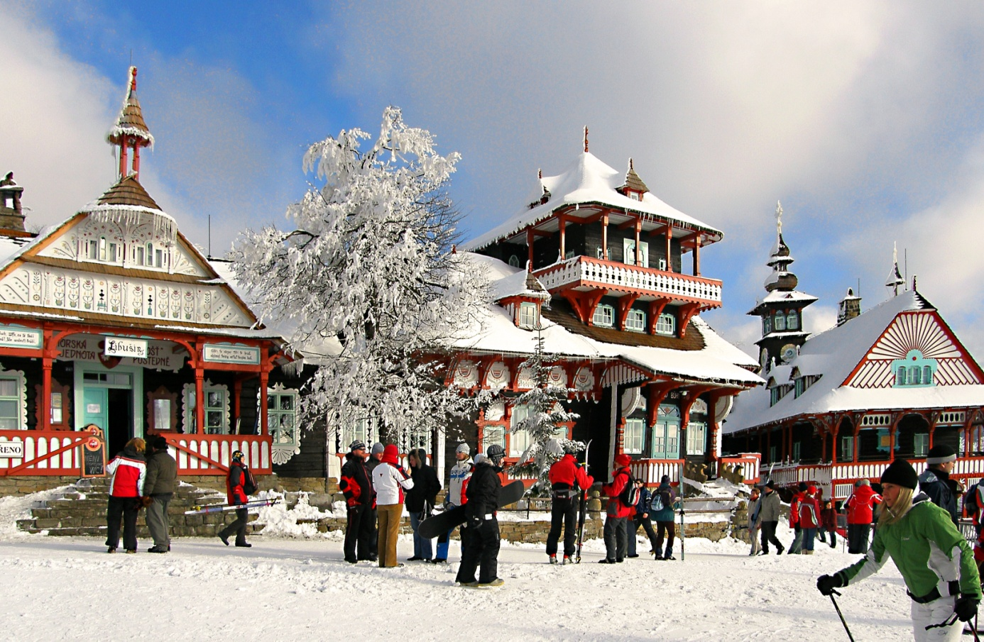

Slide 16
Example!

Slide 17
TAKK!
TACK!
DANKE!
MERCI!
OBRIGADO!

