Slide 1
Kvadratická funkce
$$f: y=ax^{2}+bx+c$$
$a, b, c∈R, a≠0$
$$D\left(f\right)=R$$
např.: $f_{1}: y=x^{2}+6x+7⟹a=1, b=6, c=7$
$$f_{2}: y=−\frac{1}{5}x^{2}−1⟹a=−\frac{1}{5}, b=0, c=−1$$
$$f_{3}: y={3x}^{2}−4x⟹a=3, b=−4, c=0$$
$$f_{4}: y={\frac{1}{2}x}^{2}⟹a=\frac{1}{2}, b=0, c=0$$
POC 2014/15

Slide 2
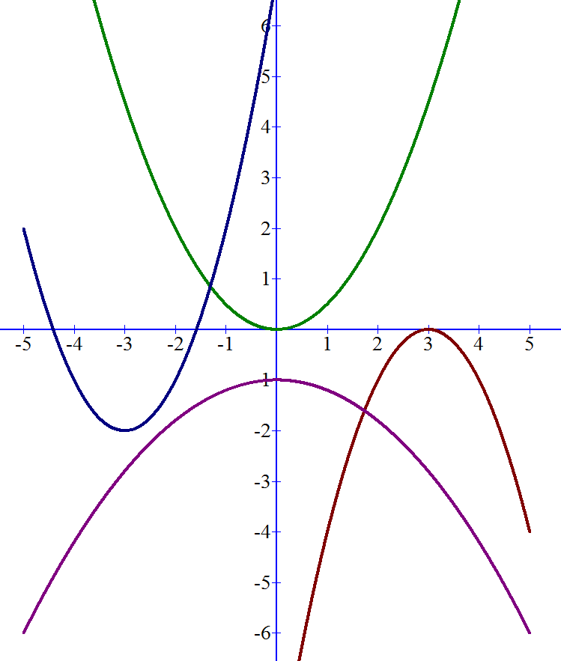
y
grafem fce je
parabola
s vrcholem
v bodě
$\left[−\frac{b}{2a};c−\frac{b^{2}}{4a}\right]$
$f_{1}: y={\frac{1}{2}x}^{2}$
x
$f_{2}: y=x^{2}+6x+7$
$f_{3}: y=−\frac{1}{5}x^{2}−1$
$$f_{4}: y={−x}^{2}+6x−9$$
POC 2014/15

Slide 3
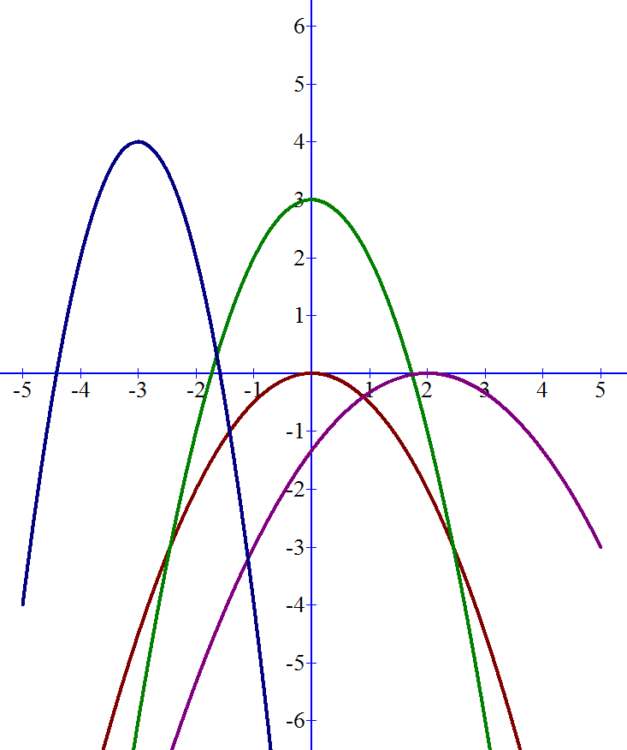
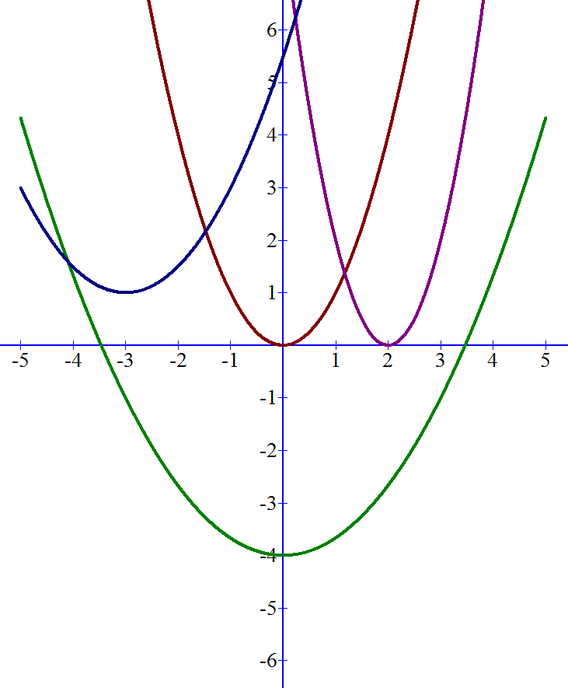
Význam koeficientu $a$
$f: y=ax^{2}+bx+c$
$f: y=ax^{2}+bx+c$
y
y
$$f_{1}: y=x^{2}=1x^{2}$$
$$f_{1}: y=−2x^{2}−12x−14$$
$$a<0$$
$$f_{2}: y=2x^{2}−8x+8$$
$f_{3}: y=$ $\frac{1}{2}x^{2}+3x+\frac{11}{2}$
$$f_{2}: y=−x^{2}+3=−1x^{2}+3$$
x
x
$f_{4}: y=\frac{1}{3}$ $x^{2}−4$
$f_{4}: y=$ $−\frac{1}{3}x^{2}+\frac{4}{3}x−\frac{4}{3}$
$$a>0$$
$f_{3}: y=−\frac{1}{2}$ $x^{2}$
parabola vrcholem dolů
parabola vrcholem nahoru
POC 2014/15

Slide 4
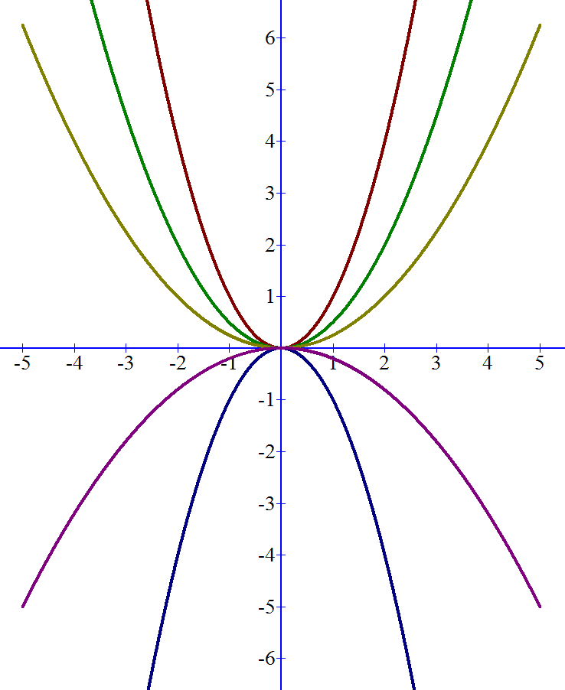
$f_{2}: y={\frac{1}{2}x}^{2}$
$f_{1}: y=x^{2}$
y
a) kvadratická fce
$$f: y=ax^{2}$$
$a∈R, a≠0$
$f_{3}: y={\frac{1}{4}x}^{2}$
$$D\left(f\right)=R$$
x
$f_{4}: y=−\frac{1}{5}x^{2}$
grafem fce je parabola
s vrcholem v počátku
souřadné soustavy
$$f_{5}: y=−x^{2}$$
POC 2014/15

Slide 5
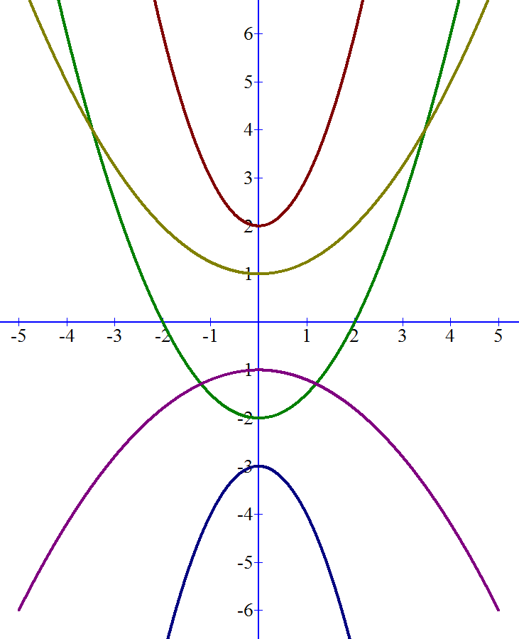
$f_{1}: y=x^{2}+2$
y
b) kvadratická fce
$f_{2}: y={\frac{1}{4}x}^{2}+1$
$$f: y=ax^{2}+c$$
$a,c∈R, a≠0$
$$D\left(f\right)=R$$
x
$f_{3}: y={\frac{1}{2}x}^{2}−2$
grafem fce je parabola
s vrcholem na ose $y$
v bodě $\left[0;c\right]$
$f_{4}: y=−\frac{1}{5}x^{2}−1$
$$f_{5}: y=−x^{2}−3$$
POC 2014/15

Slide 6
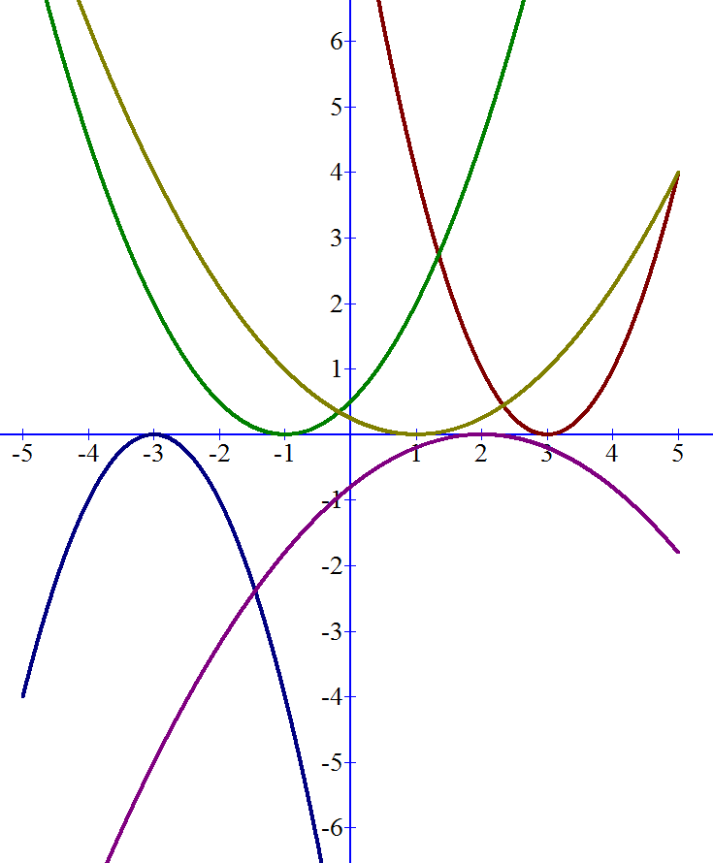
$f_{2}: y=\frac{1}{2}{\left(x+1\right)}^{2}=\frac{1}{2}{\left[x−\left(−1\right)\right]}^{2}$
$f_{1}: y={\frac{1}{4}\left(x−1\right)}^{2}$
y
c) kvadratická fce
$f_{3}: y={\left(x−3\right)}^{2}$
$$f: y=a{\left(x−x_{0}\right)}^{2}$$
$a∈R, a≠0$
$$D\left(f\right)=R$$
x
$f_{4}: y=−\frac{1}{5}{\left(x−2\right)}^{2}$
grafem fce je parabola
s vrcholem na ose $x$
v bodě $\left[x_{0};0\right]$
$$f_{5}: y=−{\left(x+3\right)}^{2}=−{\left[x−\left(−3\right)\right]}^{2}$$
POC 2014/15

Slide 7
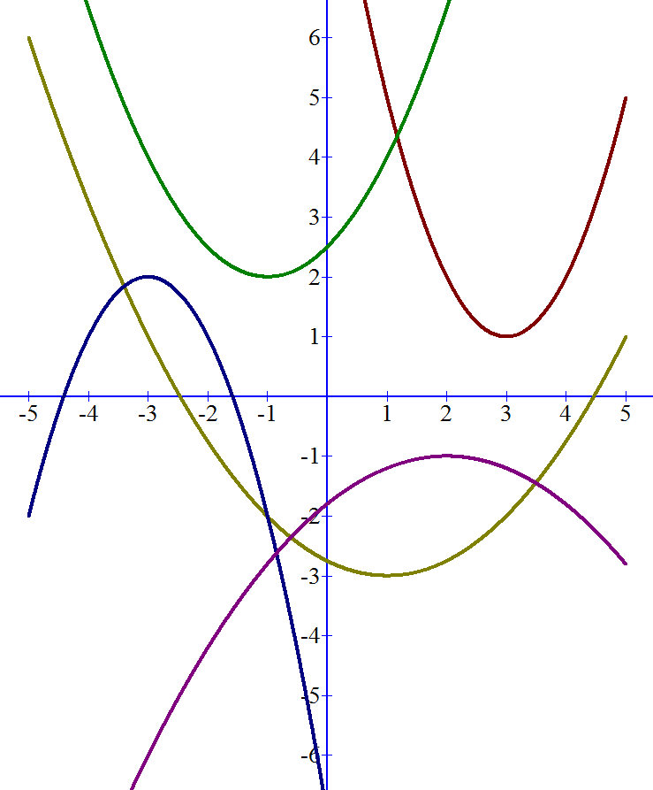
$f_{2}: y=\frac{1}{2}{\left(x+1\right)}^{2}+2=\frac{1}{2}{\left[x−\left(−1\right)\right]}^{2}+2$
$f_{1}: y={\frac{1}{4}\left(x−1\right)}^{2}−3$
y
d) kvadratická fce
$$f: y=a{\left(x−x_{0}\right)}^{2}+y_{0}$$
$a∈R, a≠0$
$f_{3}: y={\left(x−3\right)}^{2}+1$
$$D\left(f\right)=R$$
x
grafem fce je parabola
s vrcholem
v bodě $\left[x_{0};y_{0}\right]$
$f_{4}: y=−\frac{1}{5}{\left(x−2\right)}^{2}−1$
$$f_{5}: y=−{\left(x+3\right)}^{2}+2=−{\left[x−\left(−3\right)\right]}^{2}+2$$
POC 2014/15

