Slide 1
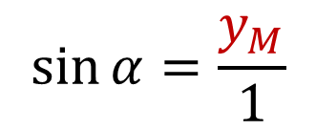
Sinus
$y$
$1$
$$M$$
$y_{M}$
$$\sin{α}= ?$$
$$1$$
$α$
$$\sin{α}=\frac{y_{M}}{1}$$
$−1$
$0$
$x_{M}$
$1$
$x$
$\sin{α}=y_{M}$
$−1$

Slide 2
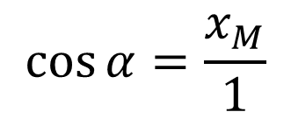
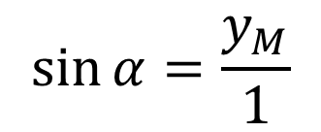
Sinus
$y$
$1$
$$\sin{α}=\frac{y_{M}}{1}$$
$$M$$
$y_{M}$
$$1$$
$\sin{α}=y_{M}$
$α$
$−1$
$0$
$x_{M}$
$1$
$x$
$$\cos{α}=\frac{x_{M}}{1}$$
$\cos{α}=x_{M}$
$−1$

Slide 3
Sinus
$y$
$1$
$$N$$
$y_{N}$
$\sin{α}=y_{M}$
$$M$$
$y_{M}$
$β$
$\sin{β}=y_{N}$
$α$
$−1$
$γ$
$1$
$x$
$\sin{γ}=y_{O}$
$δ$
$$O$$
$y_{O}$
$\sin{δ}=y_{P}$
$y_{P}$
$$P$$
$−1$

Slide 4
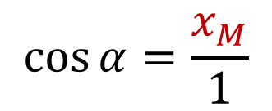
Kosinus
$y$
$1$
$$M$$
$y_{M}$
$$\cos{α}= ?$$
$$1$$
$α$
$$\cos{α}=\frac{x_{M}}{1}$$
$−1$
$0$
$x_{M}$
$1$
$x$
$\cos{α}=x_{M}$
$−1$

Slide 5
Kosinus
$y$
$1$
$$N$$
$\cos{α}=x_{M}$
$$M$$
$β$
$\cos{β}=x_{N}$
$x_{O}$
$x_{P}$
$α$
$−1$
$x_{N}$
$γ$
$x_{M}$
$1$
$x$
$\cos{γ}=x_{O}$
$δ$
$$O$$
$\cos{δ}=x_{P}$
$$P$$
$−1$

Slide 6
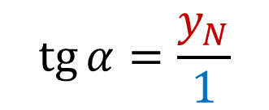
Tangens
$y$
$1$
$y_{N}$
$$N$$
$$\operatorname{tg}{α}= ?$$
$α$
$$\operatorname{tg}{α}=\frac{y_{N}}{1}$$
$−1$
$0$
$x_{N}=1$
$1$
$x$
$\operatorname{tg}{α}=y_{N}$
$−1$

Slide 7
Tangens
$y_{P}$
$y$
$1$
$$P$$
$\operatorname{tg}{α}=y_{N}$
$y_{N}$
$$N$$
$β$
$\operatorname{tg}{β}=y_{O}$
$α$
$−1$
$γ$
$1$
$x$
$\operatorname{tg}{γ}=y_{P}$
$δ$
$\operatorname{tg}{δ}=y_{Q}$
$$O$$
$−1$
$y_{O}$
$y_{Q}$
$$Q$$

Slide 8
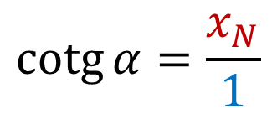
Kotangens
$y$
$1$
$y_{N}=1$
$$N$$
$α$
$−1$
$0$
$1$
$x_{N}$
$x$
$$\operatorname{cotg}{α}= ?$$
$$\operatorname{cotg}{α}=\frac{x_{N}}{1}$$
$−1$
$\operatorname{cotg}{α}=x_{N}$

Slide 9
Kotangens
$y$
$$O$$
$$Q$$
$1$
$$P$$
$$N$$
$β$
$α$
$−1$
$x_{O}$
$x_{Q}$
$γ$
$x_{P}$
$1$
$x_{N}$
$x$
$δ$
$\operatorname{cotg}{α}=x_{N}$
$\operatorname{cotg}{β}=x_{O}$
$−1$
$\operatorname{cotg}{γ}=x_{P}$
$\operatorname{cotg}{δ}=x_{Q}$

Slide 10
Tangens
$\operatorname{tg}{α}=\frac{\sin{α}}{\cos{α}},\cos{α}≠0$
Kotangens
$\operatorname{cotg}{α}=\frac{\cos{α}}{\sin{α}},$ $\sin{α}≠0$

Slide 11
Graf fce $f:y=\sin{α}$ (sinusoida)
$y$
$1$
$\frac{3π}{2}$
$$2π$$
$+$
$+$
$270°$
$360°$
$0°$
$90°$
$180°$
$x$
$−$
$−$
$0$
$\frac{π}{2}$
$$π$$
$−1$
základní perioda $2π$
$D\left(f\right)=R$
$H\left(f\right)=\left\langle −1;1\right\rangle$
lichá, omezená shora i zdola
minimum rovno $−1$ v bodech $x_{min}=\frac{3π}{2}+2kπ;k∈Z$
maximum rovno $1$ v bodech $x_{max}=\frac{π}{2}+2kπ;k∈Z$

Slide 12
Graf fce $f:y=\cos{α}$ (kosinusoida)
$y$
$1$
$$π$$
$+$
$180°$
$+$
$0°$
$90°$
$270°$
$360°$
$x$
$0$
$\frac{π}{2}$
$−$
$−$
$$2π$$
$\frac{3π}{2}$
$−1$
základní perioda $2π$
$D\left(f\right)=R$
$H\left(f\right)=\left\langle −1;1\right\rangle$
sudá, omezená shora i zdola
minimum rovno $−1$ v bodech $x_{min}=π+2kπ;k∈Z$
maximum rovno $1$ v bodech $x_{max}=0+2kπ;k∈Z$

Slide 13
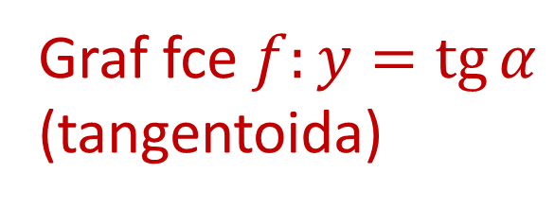
$y$
Graf fce $f:y=\operatorname{tg}{α}$
(tangentoida)
základní perioda $π$
$1$
–
$$2π$$
$D\left(f\right)=R∖\left\{\frac{π}{2}+kπ;k∈Z\right\}$
$+$
$+$
$360°$
$0°$
$90°$
$180°$
$270°$
$x$
$H\left(f\right)=$ $R$
$−$
$−$
$0$
$\frac{π}{2}$
$$π$$
$\frac{3π}{2}$
$−1$
–
lichá, není omezená ani shora ani zdola
nemá ani minimum ani maximum

Slide 14
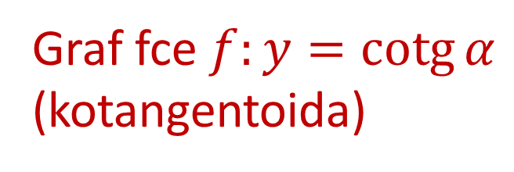
$y$
Graf fce $f:y=\operatorname{cotg}{α}$
(kotangentoida)
základní perioda $π$
$1$
–
$$π$$
$$2π$$
$+$
$+$
$180°$
$360°$
$D\left(f\right)=R∖\left\{kπ;k∈Z\right\}$
$x$
$0°$
$90°$
$−$
$270°$
$−$
$H\left(f\right)=$ $R$
$0$
–
$\frac{π}{2}$
$\frac{3π}{2}$
lichá, není omezená ani shora ani zdola
$−1$
nemá ani minimum ani maximum

Slide 15
Graf fce $f:y=\sin{α}$
Graf fce $f:y=\cos{α}$
$$\cos{α=\sin\left(α+\frac{π}{2}\right)}$$

Slide 16
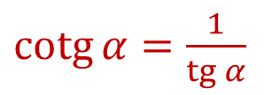
Graf fce $f:y=\operatorname{tg}{α}$
Graf fce $f:y=\operatorname{cotg}{α}$
$\operatorname{cotg}{α=\frac{1}{\operatorname{tg}{α}}}$

